Slide 1
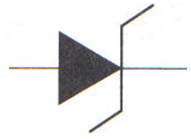
Zener Diodes
Voltage Regulation

Slide 2
Zener Diodes
Operates in reverse bias
If in parallel with a load, can keep constant voltage
Anode
Cathode

Slide 3
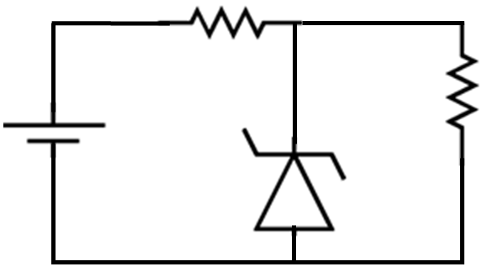
Zener Diodes
I_{S} is between I_{min} and I_{max}
Below min – does not work
Above max – will work for a while then burn up
R_{S}
E
R_{L}

Slide 4
Zener Diodes
Let:
V_{Z} = 5.1V
R_{S} = 240Ω
R_{L} = 250Ω
I_{ZK} = 4m A
I_{ZM} = 80m A
V_{RS} = 20 – 5.1
= 14.9V
V_{RL} = 5.1V
R_{S}
E
R_{L}

Slide 5
Zener Diodes
E = 20V
V_{Z} = 5.1V
R_{S} = 240Ω
R_{L} = 250Ω
I_{ZK} = 4m A
I_{ZM} = 80m A
I_{RL} = 14.9/250
= 20.4m A
I_{T} = 14.9/240
= 62.1m A
I_{Z} = I_{T} – I_{L}
= 62.m – 20.4m
= 41.7mA
R_{S}
E
R_{L}

Slide 6
Zener Diodes
I_{ZK} < I_{Z} < I_{ZM}
Power Dissipated
Load Regulation

